Slide 1

Supply Chain Project

Slide 2
Our Team Members
Mohamed El-sadek Mohamed
Tasnim Essam
Mohmed Metwally
Mariam Nagy
Mohamed AbdAlaal
NourEldeen Ali

Slide 3
Objective of the Project
Analyse Product Performance and Supply Chain Efficiency.

Slide 4
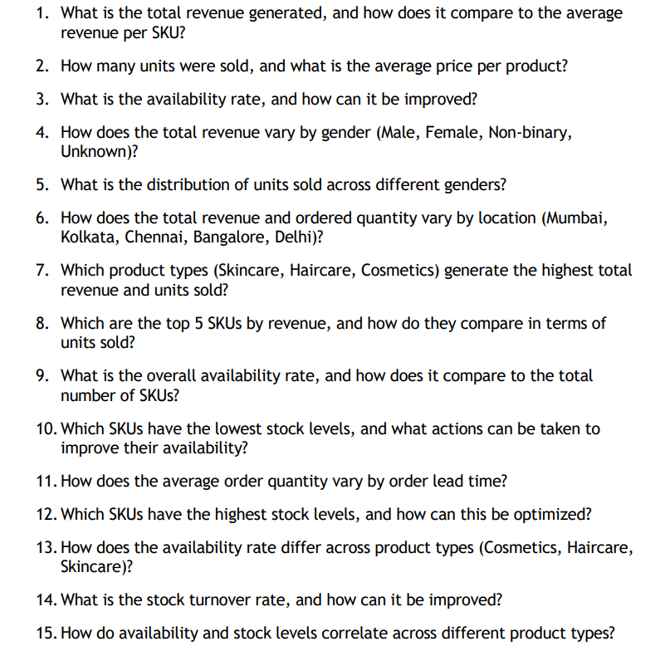
Objective Power BI

Slide 5
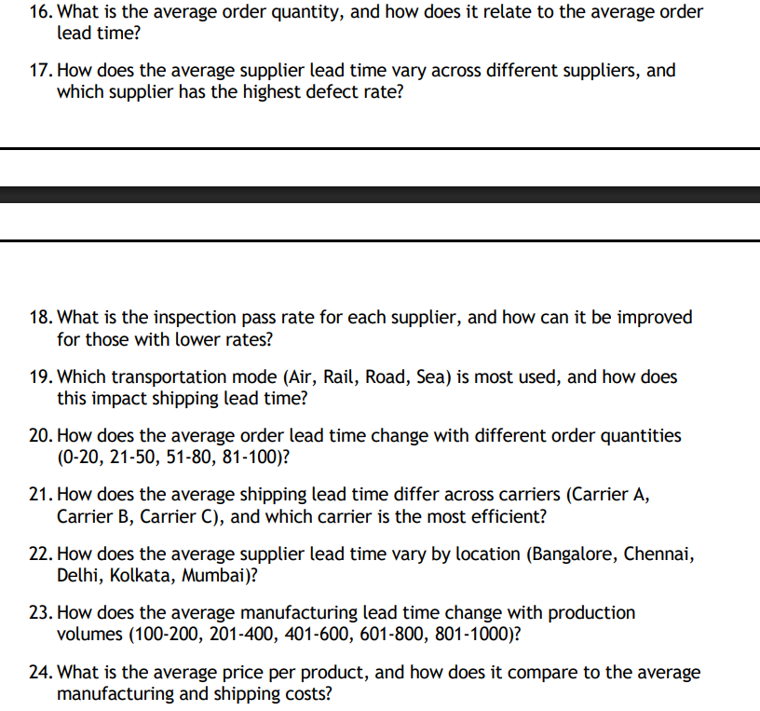

Slide 6
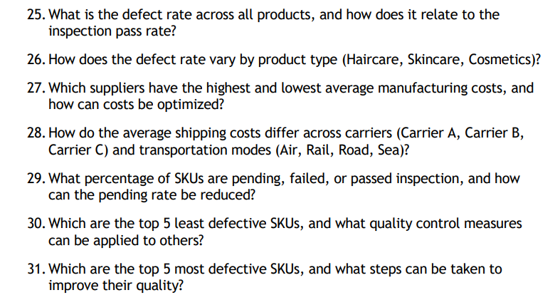

Slide 7
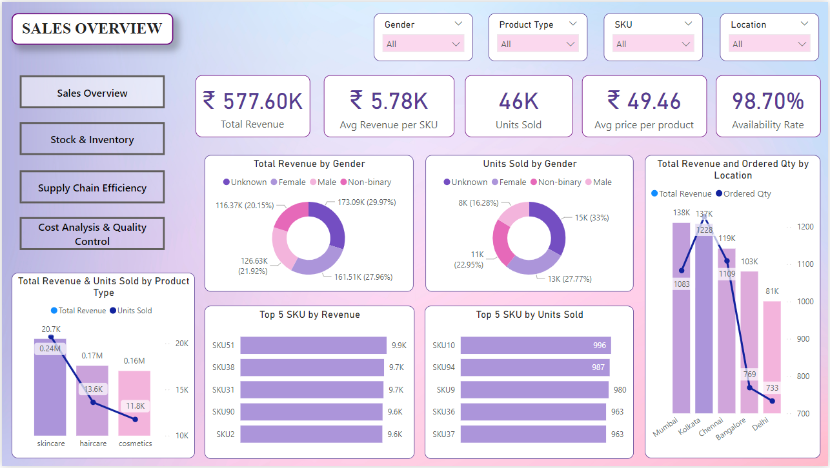
Provides a comprehensive overview of sales performance across key dimensions such as gender, product type, SKU, and location

Slide 8
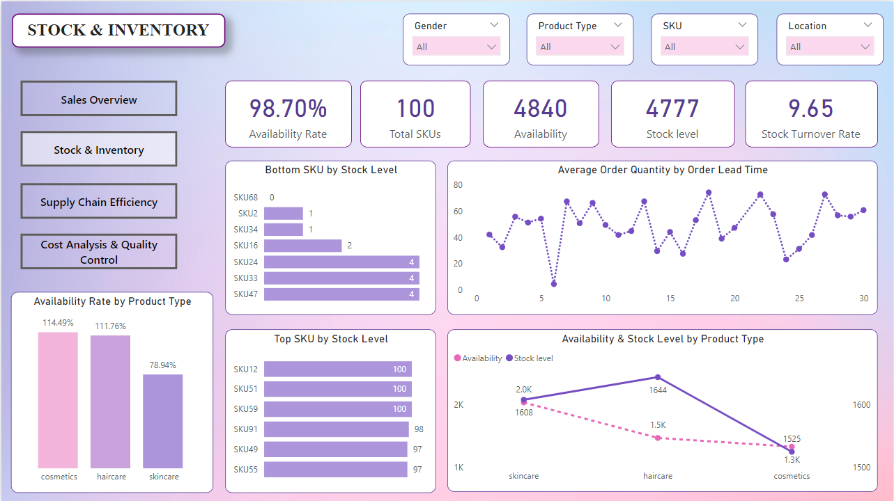
Analyses stock availability, inventory levels, and trends related to order lead time to ensure supply meets demand

Slide 9
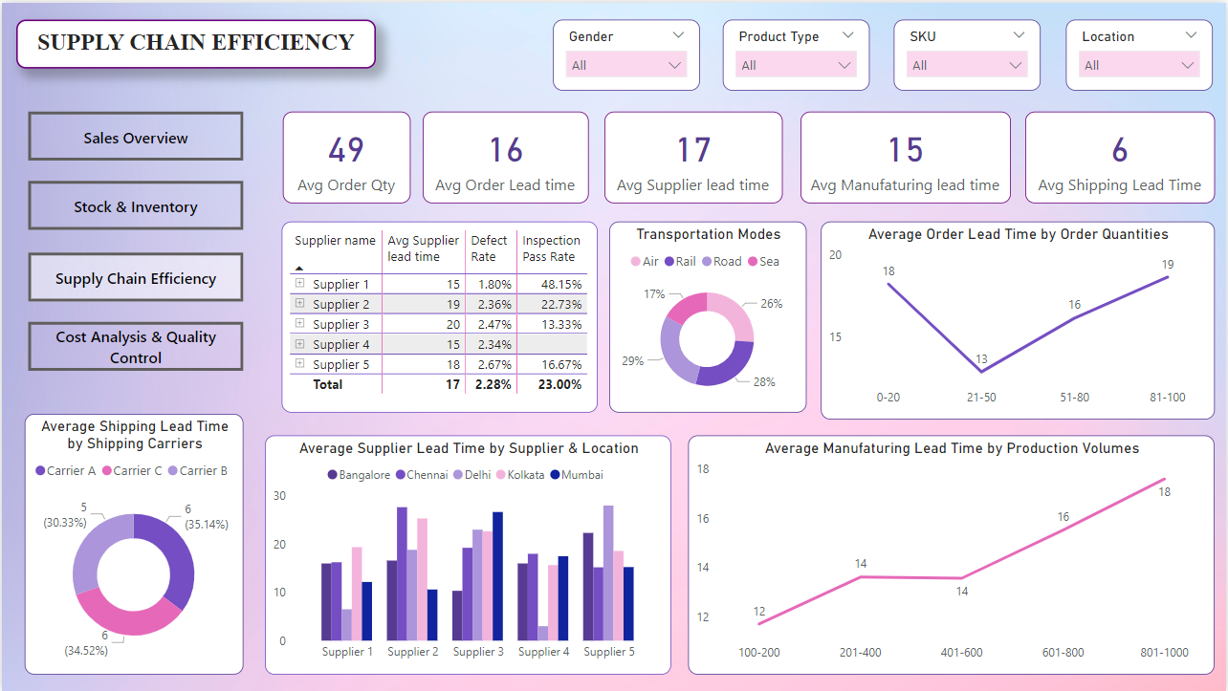
Evaluates supply chain efficiency by analysing lead time, transportation modes, supplier performance, and manufacturing quality metrics

Slide 10
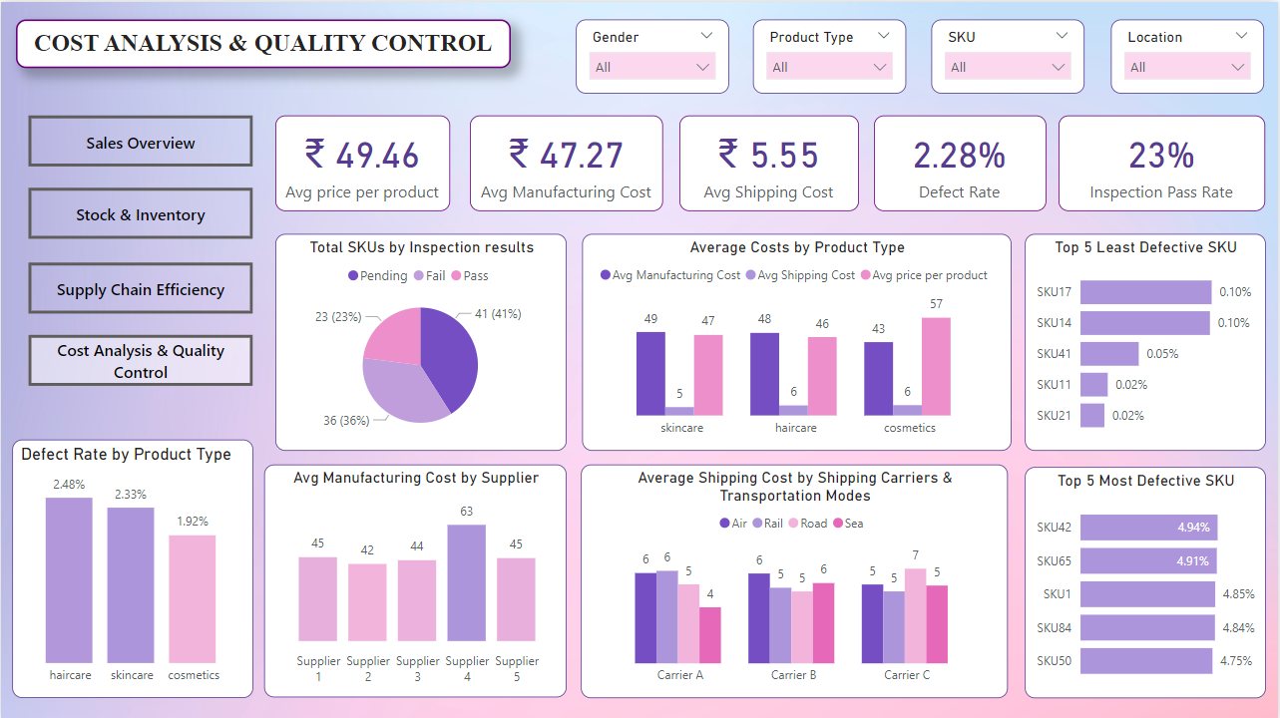
Evaluates cost efficiency and quality control metrics to identify opportunities for cost reduction and quality improvements

Slide 11
Insights:
Total revenue generated is ₹577.60K, with an average revenue per product of ₹5.78K.
Customers whose gender was Unknown contributed the highest revenue (29.97%), followed by females (27.96%). Non-binary and Males also contributed significantly.
Cities like Kolkata and Mumbai show higher revenue and ordered quantities compared to other locations like Bangalore and Delhi.
SKU51 leads the revenue with ₹9.9K, closely followed by SKU38 and SKU31.
SKU10 tops the sales with 996 units sold.
Skincare products outperform haircare and cosmetics in both revenue and units sold.
The average availability rate is 98.70, with skincare products having the highest availability (114.49) suggesting overstocking.
Haircare leads in stock levels, followed by skincare and cosmetics.
SKU68, SKU2, and SKU34 are critically low on stock, indicating potential supply chain risks.
Order quantities fluctuate significantly over the lead time, highlighting areas for optimizing inventory planning.
SKU12, SKU51, and SKU59 maintain the highest stock levels. The average order lead time is 16 days, and the average supplier lead time is 17 days, indicating potential bottlenecks in sourcing.
The average manufacturing lead time is 15 days, while the average shipping lead time is 6 days, with shipping being relatively efficient.

Slide 12
Insights:
Rail and road transport are used almost equally, followed by air and sea.
An overall low defect rate of 2.28% indicates good manufacturing quality. The inspection pass rate of 23% could be improved.
Supplier 3 has the highest lead time (20 days) across all supplier locations. There’s a significant variation in lead times across locations.
Orders between 21–50 units have the shortest lead time (13 days), while larger orders (81–100 units) take significantly longer (19 days).
As production volumes increase, manufacturing lead time rises, reaching 18 days for the highest volume tier (801–1000 units), indicating capacity constraints.
All shipping carriers have similar average lead times (~6 days), with no significant performance differentiation.
Haircare has the highest defect rate (2.5%), while cosmetics have the lowest (1.9%).
23% of SKUs passed inspection, while 41% are pending, indicating requirement for improving inspection efficiency.
Cosmetics have the highest average price per product (₹57) and shipping cost (₹6) while skincare has highest manufacturing cost (₹49).
Skincare products have the lowest average shipping costs.
SKU42 and SKU65 show highest defect rates (4.9%).
Supplier 4 incurs the highest manufacturing cost (₹63), while others have more balanced cost structure.
Sea transportation by Carrier A provide the lowest costs, whereas road transportation by Carrier C is the costliest.

Slide 13
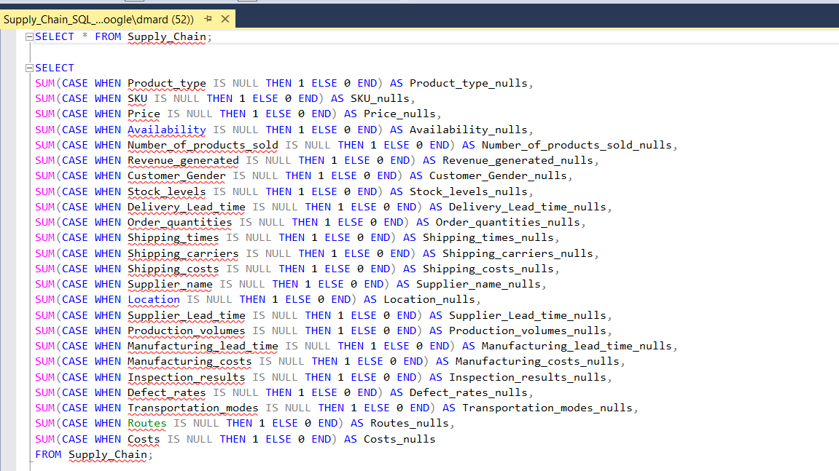

Slide 14
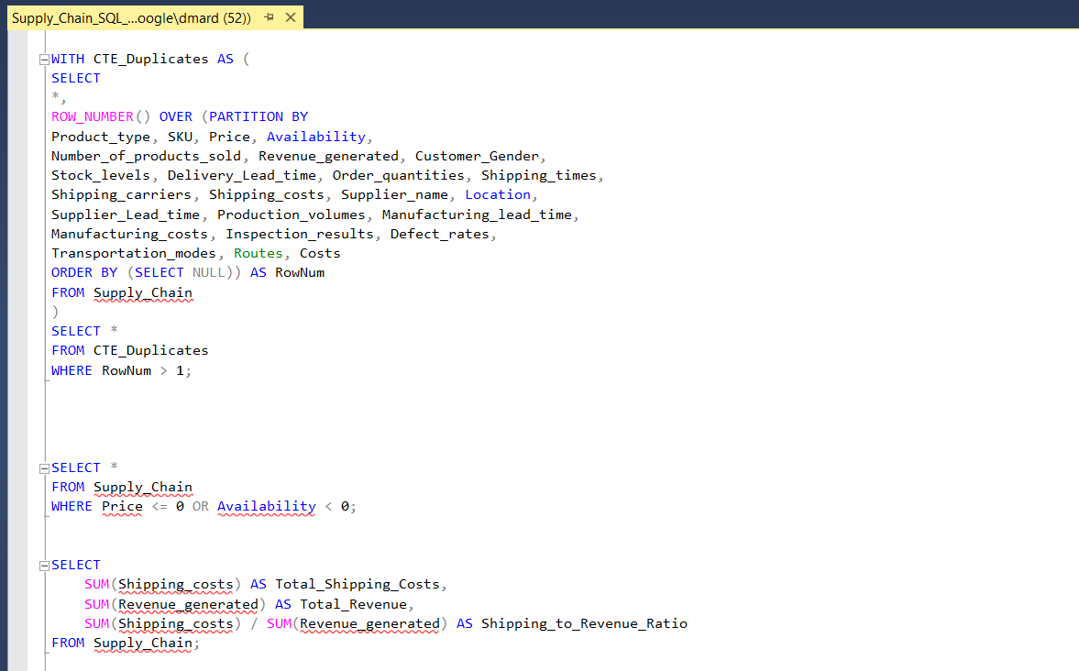

Slide 15
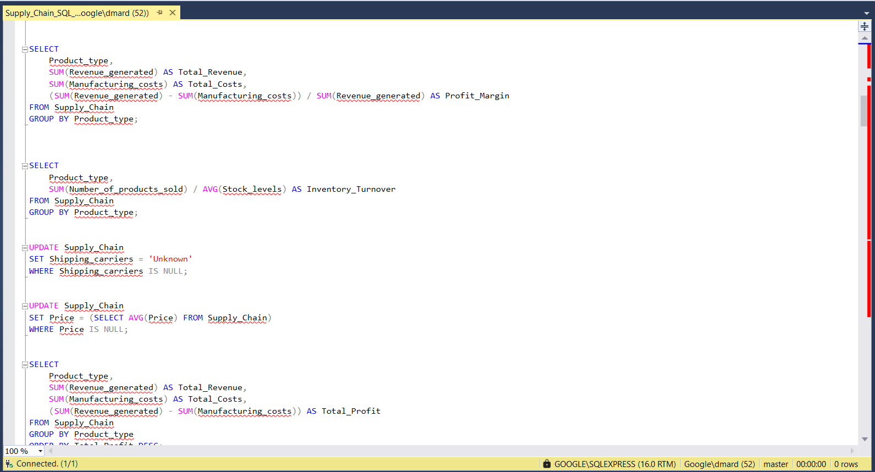

Slide 16
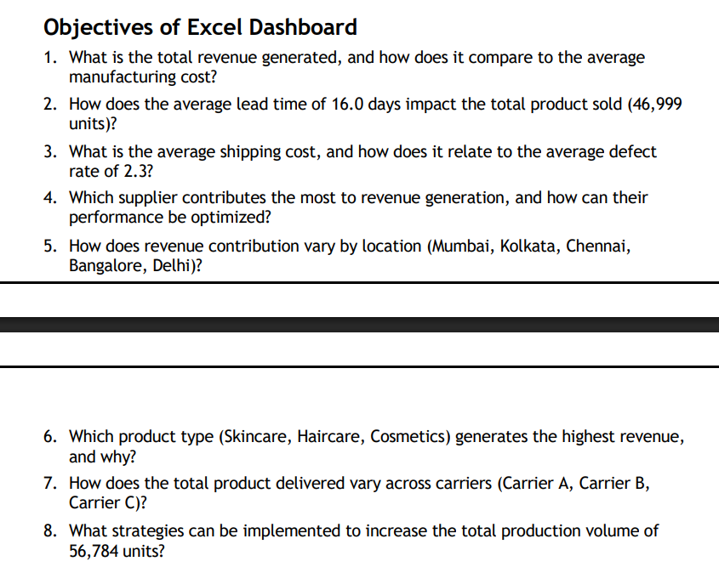

Slide 17
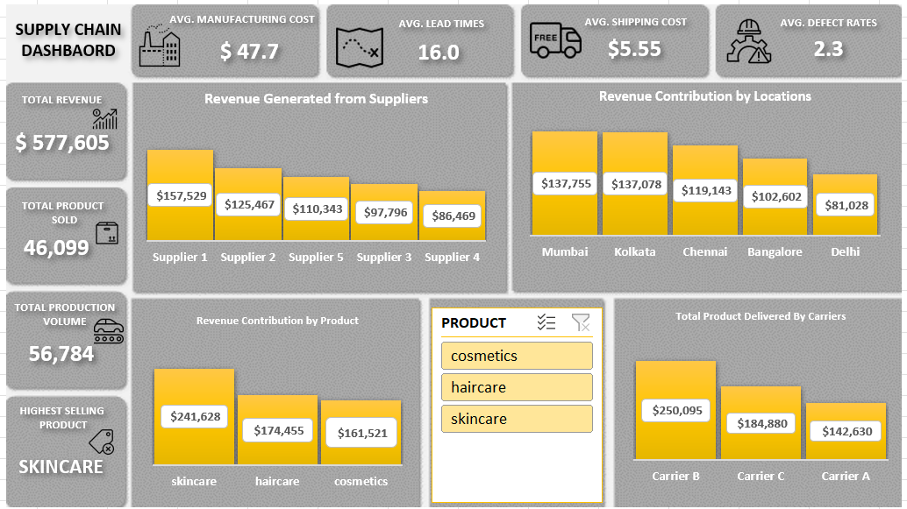

Slide 18
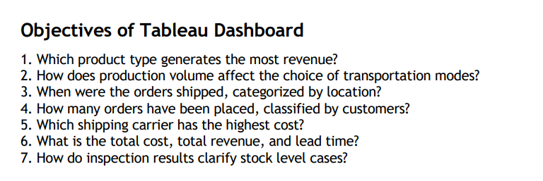

Slide 19
